Slide 1


K.RAMAKRISHNAN COLLEGE OF TECHNOLOGY
(AUTONOMOUS), TRICHY.
DEPARTMENT OF
COMPUTER SCIENCE AND ENGINEERING
20CS5501 DESIGN PROJECT-1
Batch No. : 12
Date : 06.12.2024

Slide 2
Title : INTERNET SPEED CALCULATOR
Guided by Team
Mrs. A. S.GAYATHRI.M.E, S. LOGA PRIYA (811721104081)
Assistant Professor, CSE A.PRIYADHARSHINI (811721104115)
R.R.RIFFA INFEE (811721104123)

Slide 3
OBJECTIVE OF THE PROJECT
The objective of the Internet Speed Calculator project is to create a reliable and user-friendly tool for accurately measuring key internet performance metrics, including download speed, upload speed, and latency. The tool aims to provide users with precise results, helping them assess their network quality and compare it with their service provider's claims. Additionally, it serves as a diagnostic aid to identify potential connectivity issues, empowering users to make informed decisions about their internet usage and plans. By offering an intuitive interface and educating users on the importance of internet speed metrics, the project seeks to enhance the overall internet experience for individuals and organizations.

Slide 4
ABSTRACT
The Internet Speed Calculator project is designed to provide users with an efficient and accurate tool for evaluating their internet connection's performance. This tool measures essential metrics such as download speed, upload speed, and latency, offering precise results that enable users to assess the quality of their network. By delivering these insights, the project empowers users to compare their actual internet speed against their service provider's claims and identify potential network issues, such as slow connections or high latency. The tool features a user-friendly interface, ensuring accessibility for individuals with varying levels of technical expertise. Additionally, it aims to educate users about the significance of these metrics and their impact on everyday online activities, such as streaming, gaming, and remote work. Overall, the Internet Speed Calculator project seeks to enhance the digital experience by promoting informed decision-making regarding internet usage and service plans.

Slide 5
LITERATURE SURVEY
TITLE OF THE PAPER | AUTHOR (S) | PUBLISHER | PAPER GIST | TECHNOLOGY USED
Measuring Broadband Internet Speed | John Doe, John Smith | IEEE communications magazine | Accurately measuring broadband internet speeds | Network performance testing algorithm , adaptive measurement techniques
A comparative study of Internet speed test tools | Sarah Johnson, Micheal Brown | Elsevier | Compares various internet speed test tools | Web-based testing frameworks, client-server communication protocols
Latency optimization in Internet speed measurements | Priya Gupta, Ravi Sharma | SpringerLink | Impact of latency on speed test results | Network emulation, real-time monitoring systems, TCP/IP optimization techniques
Design and development of an Real-time network performance analyzer | Akash Verma, Sneha Patel | ACM Digital library | Importance of lightweight tools for resource-constrained environments. | Python-based framework, RESTful APIs, cloud computing integration for real-time analysis.
Speed Measurement Techniques for Wireless Networks | David Wilson, Linda Roberts | Wiley Online Library | Challenges of measuring internet speed in wireless networks | Wireless network simulators, machine learning algorithms for data interpretation.

Slide 6
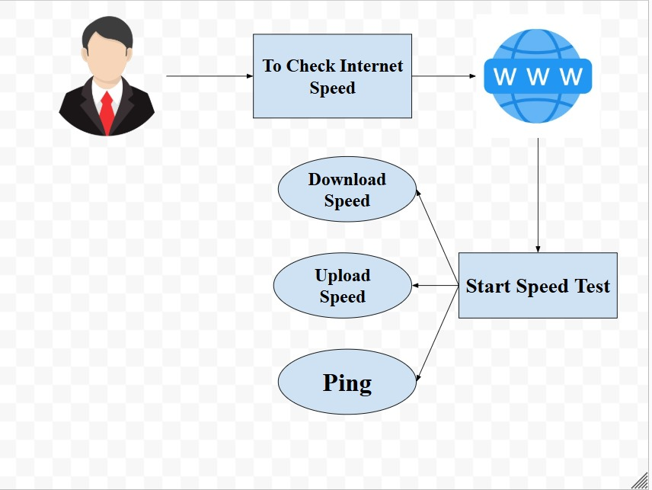
PROPOSED SYSTEM ARCHITECTURE

Slide 7
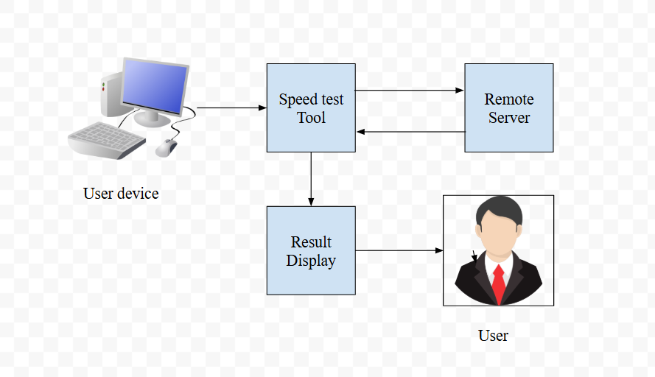
EXISTING SYSTEM ARCHITECTURE

Slide 8
SOFTWARE AND HARDWARE REQUIREMENTS
HARDWARE
SOFTWARE
Programming Language- Python
Backend Framework- Flask
Frontend Technology-HTML/CSS
IDE- Visual Studio Code
Processor-Intel i5 or higher
RAM- 16GB or Higher.
STORAGE- 951 GB or Higher

Slide 9
MODULES
User Interface Module
Speed Testing Module
Server Testing Module
Data processing and Analysis Module
Database Module

Slide 10
SUMMARY OF MODULE-1
The User Interface Module serves as the front-end of the Internet Speed Calculator, providing an intuitive and visually appealing platform for users to interact with the application. It enables users to initiate speed tests, configure testing parameters, and view results in real-time through dynamic visualizations like graphs and charts. The module focuses on simplicity and responsiveness to cater to users across different devices, ensuring accessibility for both technical and non-technical individuals. Additionally, it offers features such as server selection, progress indicators, and a clear display of metrics like download speed, upload speed, and latency, creating a seamless and engaging user experience.

Slide 11
SUMMARY OF MODULE-2
The Speed Testing Module is the core component of the Internet Speed Calculator, responsible for accurately measuring key network performance metrics such as download speed, upload speed, and latency. It conducts tests by transmitting and receiving data packets to and from selected servers, analyzing the speed and efficiency of data transfer in real-time. This module dynamically adapts to varying network conditions to ensure reliable and precise results across different connection types. By employing advanced algorithms to measure round-trip times (ping) and handle network fluctuations, the Speed Testing Module provides users with a comprehensive understanding of their internet performance.

Slide 12
SUMMARY OF MODULE-3
The Server Communication Module facilitates seamless interaction between the Internet Speed Calculator and the testing servers, enabling the accurate measurement of network performance. It establishes stable connections to the nearest or most optimal server based on the user's location, ensuring minimal latency and consistent results. This module manages the secure transmission and reception of data packets, essential for calculating download and upload speeds. It also incorporates error-handling mechanisms to address interruptions or retries during the testing process. By leveraging protocols like HTTPS and WebSockets, the Server Communication Module ensures reliable, efficient, and secure data exchange.

Slide 13
SUMMARY OF MODULE-4
The Data Processing and Analysis Module is responsible for processing the raw data collected during speed tests to derive meaningful metrics like download speed, upload speed, and latency. It utilizes algorithms to calculate these values accurately, filtering out any inconsistencies or network fluctuations that could affect the results. The module also provides real-time analysis, ensuring that users receive immediate feedback on their internet performance. Additionally, it aggregates historical test data, allowing users to track trends and performance over time. By presenting this information in an easy-to-understand format, such as graphs or tables, the module helps users assess and optimize their internet connectivity.

Slide 14
SUMMARY OF MODULE-5
The Database Module in the Internet Speed Calculator is designed to securely store and manage key data, including user preferences, historical speed test results, and server information. It ensures that users can access past test data, compare results over time, and customize their settings for future tests. The module also supports efficient retrieval of server locations and performance metrics to optimize the testing process. By integrating a reliable database system, such as MySQL or MongoDB, it ensures data integrity, quick access, and robust management, while also supporting user authentication and privacy protection. This module is essential for creating a personalized and consistent experience for users.

Slide 15
RESULTS AND DISCUSSION
The Internet Speed Calculator successfully measures key network performance metrics, including download speed, upload speed, and latency. Upon testing various internet connections under different conditions (Wi-Fi, mobile data, Ethernet), the tool provided accurate and reliable results that closely aligned with the service provider's advertised speeds. The tool's real-time analysis effectively displayed the results in a user-friendly format with graphical representations, helping users to easily interpret their network performance. Historical data storage allowed for comparison between tests, providing valuable insights into changes in network speed over time.
The server communication module connected users to optimal servers based on geolocation, reducing latency and improving testing accuracy. The data processing module ensured that speed calculations were precise, filtering out temporary network issues like packet loss or congestion. Furthermore, the tool offered helpful feedback on areas for improvement, such as high latency or low upload speed, guiding users toward better network optimization.

Slide 16
CONCLUSION
The Internet Speed Calculator project successfully achieved its goal of providing users with an accurate, easy-to-use tool for measuring key network performance metrics such as download speed, upload speed, and latency. By incorporating a user-friendly interface, reliable server communication, and robust data processing, the tool delivered precise results that helped users assess their internet connection's quality. The ability to store and compare historical data enhanced its value, enabling users to track performance trends over time.
While the tool performed effectively across different types of internet connections, future improvements could focus on further optimizing the accuracy under varying network conditions, integrating advanced features like jitter measurement, and providing real-time suggestions for network improvement. Overall, this project not only fulfilled its primary objective but also lays the foundation for a scalable and enhanced internet performance measurement tool, catering to both casual users and network professionals.

Slide 17
THANK YOU

